Slide 1
Simulated Annealing
10/7/2005

Slide 2
Local Search algorithms
Search algorithms like breadth-first, depth-first or A* explore all the search space systematically by keeping one or more paths in memory and by recording which alternatives have been explored.
When a goal is found, the path to that goal constitutes a solution.
Local search algorithms can be very helpful if we are interested in the solution state but not in the path to that goal. They operate only on the current state and move into neighboring states .

Slide 3
Local Search algorithms
Local search algorithms have 2 key advantages:
  They use very little memory
  They can find reasonable solutions in large or infinite (continuous) state spaces.
Some examples of local search algorithms are:
  Hill-climbing
  Random walk
  Simulated annealing

Slide 4
Annealing
Annealing is a thermal process for obtaining low energy states of a solid in a heat bath.
The process contains two steps:
  Increase the temperature of the heat bath to a maximum value at which the solid melts.
  Decrease carefully the temperature of the heat bath until the particles arrange themselves in the ground state of the solid. Ground state is a minimum energy state of the solid.
The ground state of the solid is obtained only if the maximum temperature is high enough and the cooling is done slowly.

Slide 5
Simulated Annealing
The process of annealing can be simulated with the Metropolis algorithm, which is based on Monte Carlo techniques.
We can apply this algorithm to generate a solution to combinatorial optimization problems assuming an analogy between them and physical many-particle systems with the following equivalences:
  Solutions in the problem are equivalent to states in a physical system.
  The cost of a solution is equivalent to the “energy” of a state.

Slide 6
Simulated Annealing
To apply simulated annealing with optimization purposes we require the following:
  A successor function that returns a “close” neighboring solution given the actual one. This will work as the “disturbance” for the particles of the system.
  A target function to optimize that depends on the current state of the system. This function will work as the energy of the system.
The search is started with a randomized state. In a polling loop we will move to neighboring states always accepting the moves that decrease the energy while only accepting bad moves accordingly to a probability distribution dependent on the “temperature” of the system.

Slide 7
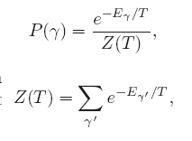
Simulated Annealing
Decrease the temperature slowly, accepting less bad moves at each temperature level until at very low temperatures the algorithm becomes a greedy hill-climbing algorithm.
The distribution used to decide if we accept a bad movement is know as Boltzman distribution.
This distribution is very well known is in solid physics and plays a central role in simulated annealing. Where γ is the current configuration of the system, E _{γ} is the energy related with it, and Z is a normalization constant.

Slide 8
Simulated Annealing: the code
1. Create random initial solution γ
2. E_{old}=cost(γ);
3. for(temp=temp_{max}; temp>=temp_{min};temp=next_temp(temp) ) {
4. for(i=0;i<i_{max}; i++ ) {
5. succesor_func(γ); //this is a randomized function
6. E_{new}=cost(γ);
7. delta=E_{new}-E_{old;}
8. if(delta>0)
9. if(random() >= exp(-delta/K*temp);
10. undo_func(γ); //rejected bad move
11. else
12. E_{old}=E_{new} //accepted bad move
13. else
14. E_{old}=E_{new;} //always accept good moves
  }
}

Slide 9
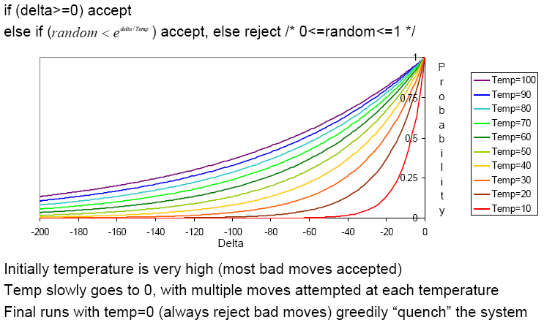
Simulated Annealing
Acceptance criterion and cooling schedule

Slide 10
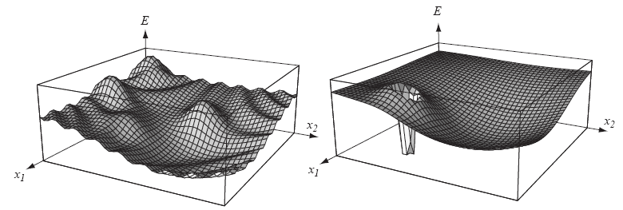
Practical Issues with simulated annealing
Cost function must be carefully developed, it has to be “fractal and smooth”.
The energy function of the left would work with SA while the one of the right would fail.

Slide 11
Practical Issues with simulated annealing
The cost function should be fast it is going to be called “millions” of times.
The best is if we just have to calculate the deltas produced by the modification instead of traversing through all the state.
This is dependent on the application.

Slide 12
Practical Issues with simulated annealing
In asymptotic convergence simulated annealing converges to globally optimal solutions.
In practice, the convergence of the algorithm depends of the cooling schedule.
There are some suggestion about the cooling schedule but it stills requires a lot of testing and it usually depends on the application.

Slide 13
Practical Issues with simulated annealing
Start at a temperature where 50% of bad moves are accepted.
Each cooling step reduces the temperature by 10%
The number of iterations at each temperature should attempt to move between 1-10 times each “element” of the state.
The final temperature should not accept bad moves; this step is known as the quenching step.

Slide 14
Applications
Basic Problems
  Traveling salesman
  Graph partitioning
  Matching problems
  Graph coloring
  Scheduling
Engineering
  VLSI design
    Placement
    Routing
    Array logic minimization
    Layout
  Facilities layout
  Image processing
  Code design in information theory

Slide 15
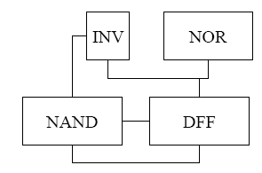
Applications: Placement
Pick relative location for each gate.
Seek to improve routeability, limit delay and reduce area.
This is achieved through the reduction of the signals per routing channel, the balancing row width and the reduction of wirelength.
The placement also has to follow some restrictions like:
  I/Os at the periphery
  Rectangular shape
  Manhattan routing
The cost function should balance this multiple objectives while the successor has to comply with the restrictions.

Slide 16
Applications: Placement
In placement there are multiple complex objective.
The cost function is difficult to balance and requires testing.
An example of cost function that balances area efficiency vs. performance.
Cost=c₁area+c₂delay+c₃power+c₄crosstalk
Where the c_{i} weights heavily depend on the application and requirements of the project

Slide 17
References
Aarst, “Simulated annealing and Boltzman machines”, Wiley, 1989.
Duda Hart Stork, “Pattern Classification”, Wiley Interscience, 2001.
Otten, “The Annealing Algorithm”, Kluwer Academic Publishers, 1989.
Sherwani, “Algorithms for VLSI Physical Design Automation”, Kluwer Academic Publishers, 1999.

